Slide 1
Linear Programming 2

Slide 2
Contents
Review
Simplex Method Demonstration
Problem Based Approach (Python)
Diet Problem (Tutorial Question 5)
Formulating with Summation Notation
Manufacturing Problem (Question 4 Adapted)
Introduction to:
  Integer and Mixed-Integer Based Programming

Slide 3
Blank Slide

Slide 4
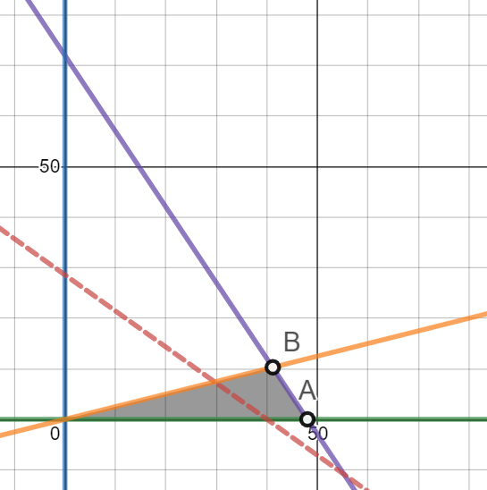




Linear Programming Model
A linear programming model can be written as follows
maximise $P=5x+7y$
subject to:
$3x+2y≤144$ (C1)
$x≥4y$ (C2)
$x≥0$
$y≥0$
$$3x+2y≤144$$
$$x≥4y$$
$$P=5x+7y$$

Slide 5
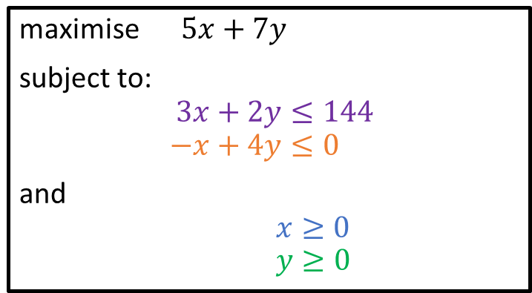
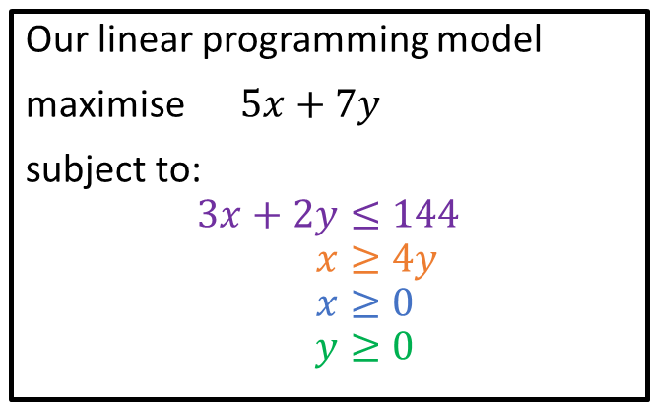
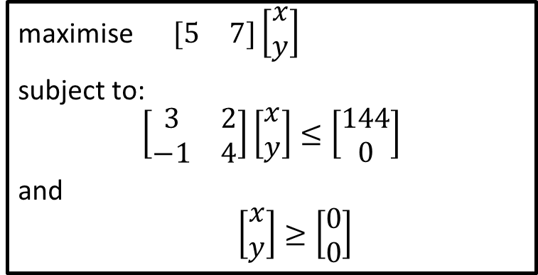
Canonical Form (Matrices)
Our linear programming model
maximise $5x+7y$
subject to:
$$3x+2y≤144 \\ x≥4y \\ x≥0 \\ y≥0$$
maximise $5x+7y$
subject to:
$$3x+2y≤144 \\ −x+4y≤0$$
and
$x≥0$
$y≥0$
maximise $\begin{matrix}[5 & 7]\left[\begin{matrix}x \\ y\end{matrix}\right]\end{matrix}$
subject to:
$$\left[\begin{matrix}3 & 2 \\ −1 & 4\end{matrix}\right]\left[\begin{matrix}x \\ y\end{matrix}\right]≤\left[\begin{matrix}144 \\ 0\end{matrix}\right]$$
and
$\left[\begin{matrix}x \\ y\end{matrix}\right]≥\left[\begin{matrix}0 \\ 0\end{matrix}\right]$

Slide 6
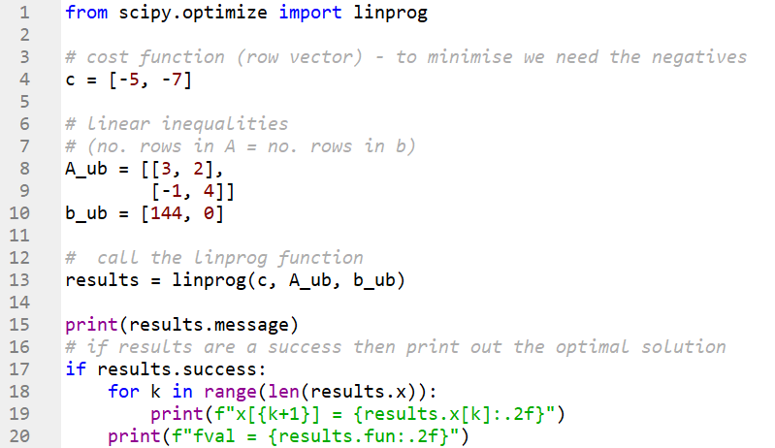
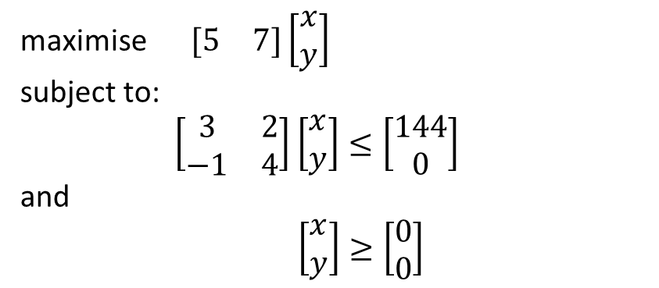
Solution with Python
maximise $\begin{matrix}[5 & 7]\left[\begin{matrix}x \\ y\end{matrix}\right]\end{matrix}$
subject to:
$\left[\begin{matrix}3 & 2 \\ −1 & 4\end{matrix}\right]\left[\begin{matrix}x \\ y\end{matrix}\right]≤\left[\begin{matrix}144 \\ 0\end{matrix}\right]$
and
$\left[\begin{matrix}x \\ y\end{matrix}\right]≥\left[\begin{matrix}0 \\ 0\end{matrix}\right]$
We are maximising.
The Scipy function linprog minimises!
Notice that in the Python code we call linprog using -f

Slide 7
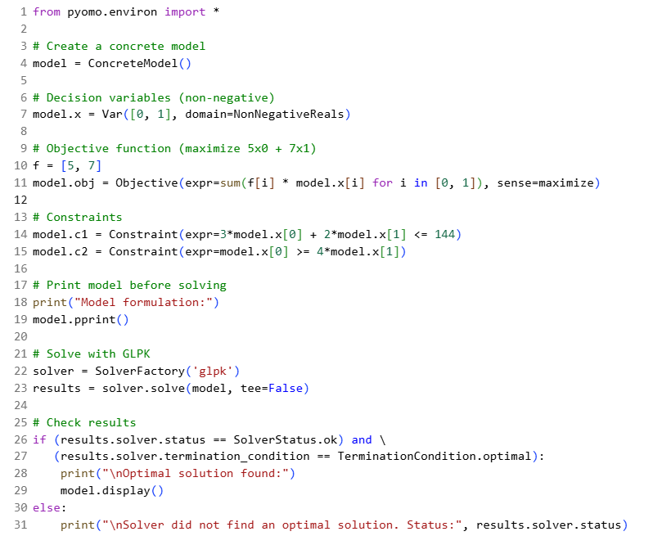
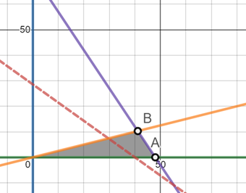
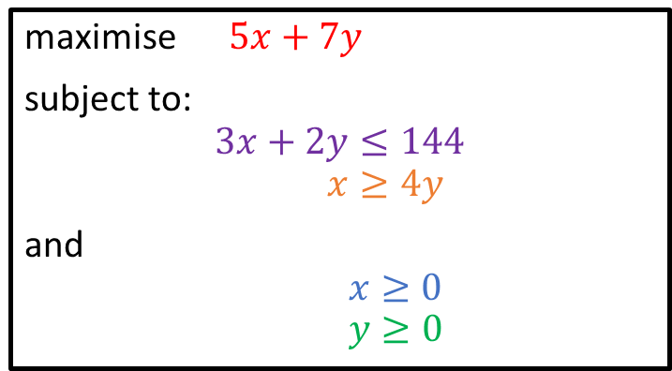



Solution with Pyomo (Modelling Language)
maximise $5x+7y$
subject to:
$$3x+2y≤144 \\ x≥4y$$
and
$x≥0$
$y≥0$
$$3x+2y≤144$$
$$P=5x+7y$$
$$x≥4y$$

Slide 8
Diet Problem (Tutorial Question 5a)
Food | Vitamin A | Vitamin B | Vitamin C | Vitamin D | Fat | Cost | Attractiveness
1 | 18 | 4 | - | 6 | - | 10 | 6
2 | 8 | 6 | 22 | 14 | - | 6 | 1
3 | 22 | 10 | - | - | 8 | 8 | 5
4 | 6 | 12 | - | 6 | - | 16 | 5
5 | - | 14 | - | 10 | - | 8 | 6
6 | - | - | 20 | 8 | 6 | 3 | 4
7 | 8 | - | - | 6 | 20 | 6 | 10
8 | 4 | - | 8 | - | 40 | 8 | 10
9 | - | 6 | 10 | 12 | - | 12 | 6
10 | 12 | 20 | - | 4 | - | 12 | 7
 | Minimum | Maximum
Vitamin A | 100 | -
Vitamin B | 120 | -
Vitamin C | 200 | -
Vitamin D | 80 | -
Fat | - | 300
The meals provided must satisfy certain basic restriction on vitamin and fat content. The right table gives the target quantities for a sample of 4 vitamins and one fat type.
The quantities of each nutrient contained in one unit of each of 10 foods and the cost and attractiveness of a unit of each food is given in the left table.
  Obtain the optimal solution given that the aim is to minimise the cost of the diet.

Slide 9
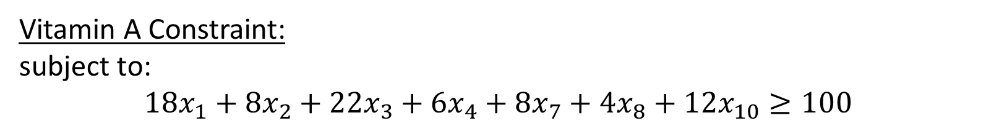
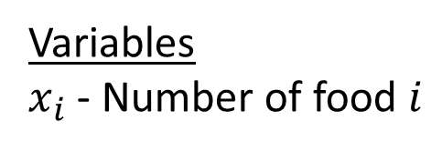
Diet Problem (Tutorial Question 5a)
Food | Vitamin A | Vitamin B | Vitamin C | Vitamin D | Fat | Cost | Attractiveness
1 | 18 | 4 | - | 6 | - | 10 | 6
2 | 8 | 6 | 22 | 14 | - | 6 | 1
3 | 22 | 10 | - | - | 8 | 8 | 5
4 | 6 | 12 | - | 6 | - | 16 | 5
5 | - | 14 | - | 10 | - | 8 | 6
6 | - | - | 20 | 8 | 6 | 3 | 4
7 | 8 | - | - | 6 | 20 | 6 | 10
8 | 4 | - | 8 | - | 40 | 8 | 10
9 | - | 6 | 10 | 12 | - | 12 | 6
10 | 12 | 20 | - | 4 | - | 12 | 7
 | Minimum | Maximum
Vitamin A | 100 | -
Vitamin B | 120 | -
Vitamin C | 200 | -
Vitamin D | 80 | -
Fat | - | 300
Variables
$x_{i}$ - Number of food $i$
Objective:
minimise $10x_{1}+6x_{2}+8x_{3}+16x_{4}+8x_{5}+3x_{6}+6x_{7}+8x_{8}+12x_{9}+12x_{10}$
Vitamin A Constraint:
subject to:
$$18x_{1}+8x_{2}+22x_{3}+6x_{4}+8x_{7}+4x_{8}+12x_{10}≥100$$

Slide 10
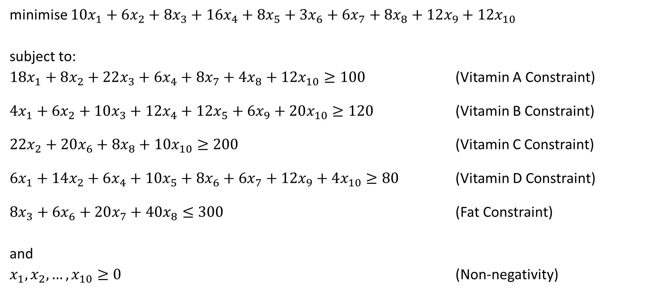
Diet Problem (Tutorial Question 5a)
minimise $10x_{1}+6x_{2}+8x_{3}+16x_{4}+8x_{5}+3x_{6}+6x_{7}+8x_{8}+12x_{9}+12x_{10}$
subject to:
$18x_{1}+8x_{2}+22x_{3}+6x_{4}+8x_{7}+4x_{8}+12x_{10}≥100$ (Vitamin A Constraint)
$4x_{1}+6x_{2}+10x_{3}+12x_{4}+12x_{5}+6x_{9}+20x_{10}≥120$ (Vitamin B Constraint)
$22x_{2}+20x_{6}+8x_{8}+10x_{10}≥200$ (Vitamin C Constraint)
$6x_{1}+14x_{2}+6x_{4}+10x_{5}+8x_{6}+6x_{7}+12x_{9}+4x_{10}≥80$ (Vitamin D Constraint)
$8x_{3}+6x_{6}+20x_{7}+40x_{8}≤300$ (Fat Constraint)
and
$x_{1},x_{2},…,x_{10}≥0$ (Non-negativity)

Slide 11
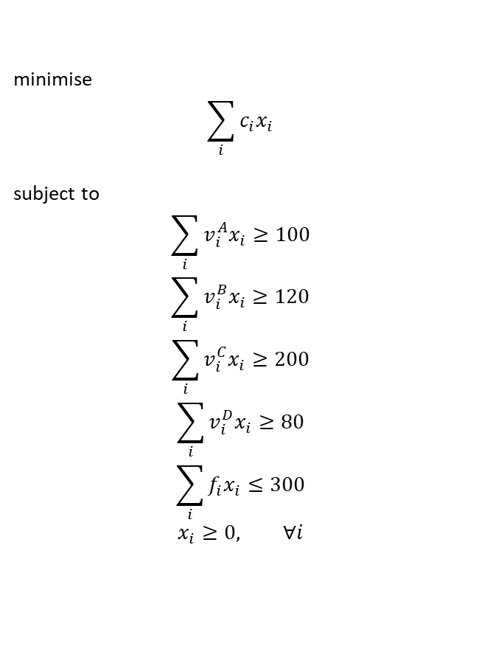
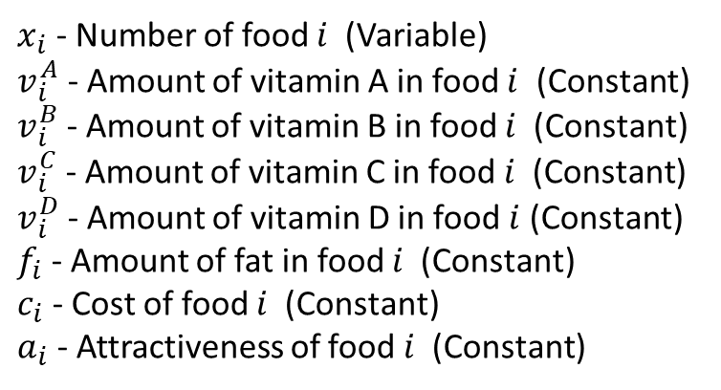
Diet Problem (Tutorial Question 5a)
Food | Vitamin A | Vitamin B | Vitamin C | Vitamin D | Fat | Cost | Attractiveness
1 | 18 | 4 | - | 6 | - | 10 | 6
2 | 8 | 6 | 22 | 14 | - | 6 | 1
3 | 22 | 10 | - | - | 8 | 8 | 5
4 | 6 | 12 | - | 6 | - | 16 | 5
5 | - | 14 | - | 10 | - | 8 | 6
6 | - | - | 20 | 8 | 6 | 3 | 4
7 | 8 | - | - | 6 | 20 | 6 | 10
8 | 4 | - | 8 | - | 40 | 8 | 10
9 | - | 6 | 10 | 12 | - | 12 | 6
10 | 12 | 20 | - | 4 | - | 12 | 7
 | Minimum | Maximum
Vitamin A | 100 | -
Vitamin B | 120 | -
Vitamin C | 200 | -
Vitamin D | 80 | -
Fat | - | 300
minimise
$$\sum_{i}{c_{i}x_{i}}$$
subject to
$$\sum_{i}{v_{i}^{A}x_{i}}≥100$$
$$\sum_{i}{v_{i}^{B}x_{i}}≥120$$
$$\sum_{i}{v_{i}^{C}x_{i}}≥200$$
$$\sum_{i}{v_{i}^{D}x_{i}}≥80$$
$$\sum_{i}{f_{i}x_{i}}≤300$$
$$x_{i}≥0, ∀i$$
$x_{i}$ - Number of food $i$ (Variable)
$v_{i}^{A}$ - Amount of vitamin A in food $i$ (Constant)
$v_{i}^{B}$ - Amount of vitamin B in food $i$ (Constant)
$v_{i}^{C}$ - Amount of vitamin C in food $i$ (Constant)
$v_{i}^{D}$ - Amount of vitamin D in food $i$ (Constant)
$f_{i}$ - Amount of fat in food $i$ (Constant)
$c_{i}$ - Cost of food $i$ (Constant)
$a_{i}$ - Attractiveness of food $i$ (Constant)

Slide 12
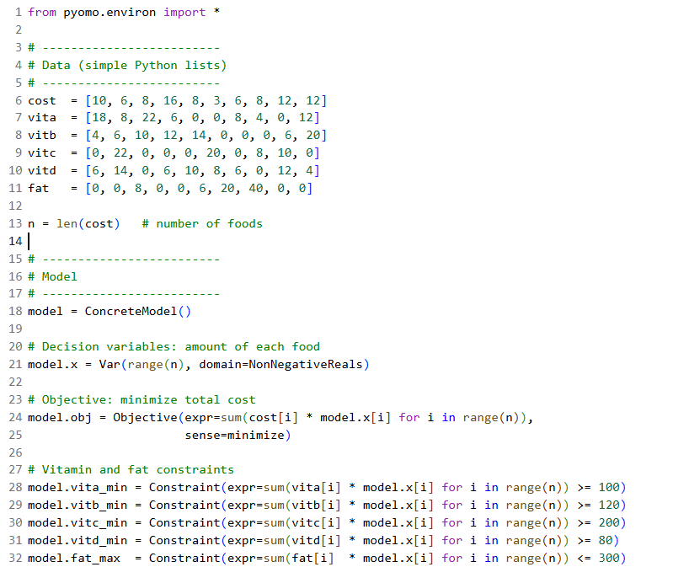
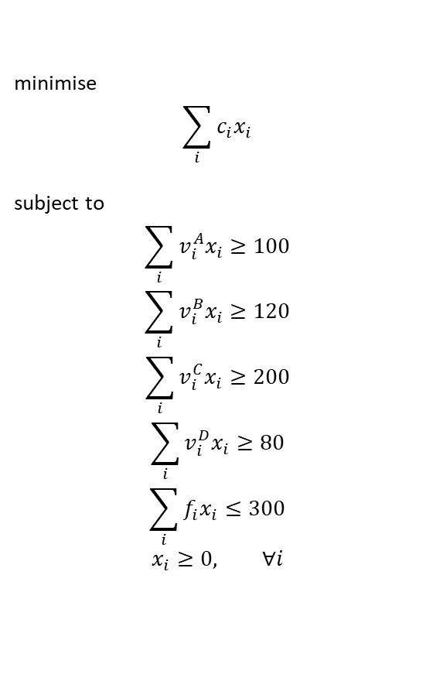
5a Solution via Pyomo (Problem Based)
minimise
$$\sum_{i}{c_{i}x_{i}}$$
subject to
$$\sum_{i}{v_{i}^{A}x_{i}}≥100$$
$$\sum_{i}{v_{i}^{B}x_{i}}≥120$$
$$\sum_{i}{v_{i}^{C}x_{i}}≥200$$
$$\sum_{i}{v_{i}^{D}x_{i}}≥80$$
$$\sum_{i}{f_{i}x_{i}}≤300$$
$$x_{i}≥0, ∀i$$

Slide 13
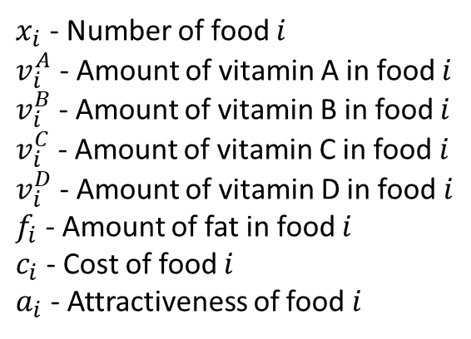
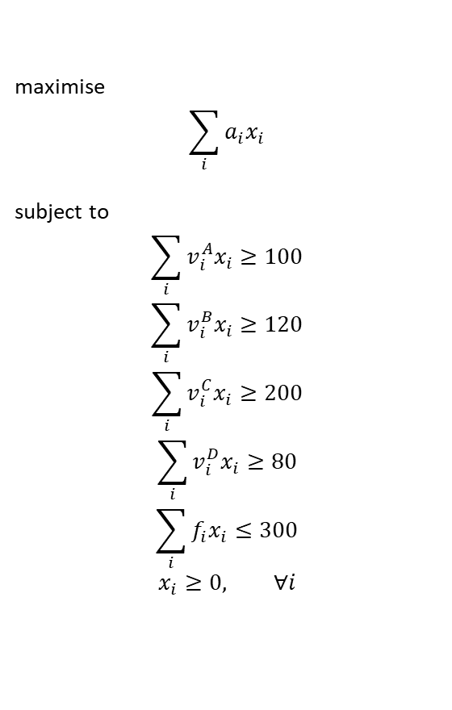
Diet Problem (Tutorial Question 5b)
$x_{i}$ - Number of food $i$
$v_{i}^{A}$ - Amount of vitamin A in food $i$
$v_{i}^{B}$ - Amount of vitamin B in food $i$
$v_{i}^{C}$ - Amount of vitamin C in food $i$
$v_{i}^{D}$ - Amount of vitamin D in food $i$
$f_{i}$ - Amount of fat in food $i$
$c_{i}$ - Cost of food $i$
$a_{i}$ - Attractiveness of food $i$
minimise
$$\sum_{i}{c_{i}x_{i}}$$
subject to
$$\sum_{i}{v_{i}^{A}x_{i}}≥100$$
$$\sum_{i}{v_{i}^{B}x_{i}}≥120$$
$$\sum_{i}{v_{i}^{C}x_{i}}≥200$$
$$\sum_{i}{v_{i}^{D}x_{i}}≥80$$
$$\sum_{i}{f_{i}x_{i}}≤300$$
$$x_{i}≥0, ∀i$$
maximise
$$\sum_{i}{a_{i}x_{i}}$$
subject to
$$\sum_{i}{v_{i}^{A}x_{i}}≥100$$
$$\sum_{i}{v_{i}^{B}x_{i}}≥120$$
$$\sum_{i}{v_{i}^{C}x_{i}}≥200$$
$$\sum_{i}{v_{i}^{D}x_{i}}≥80$$
$$\sum_{i}{f_{i}x_{i}}≤300$$
$$x_{i}≥0, ∀i$$
  Obtain the optimal solution given that the aim is to maximise the attractiveness of the diet.

Slide 14
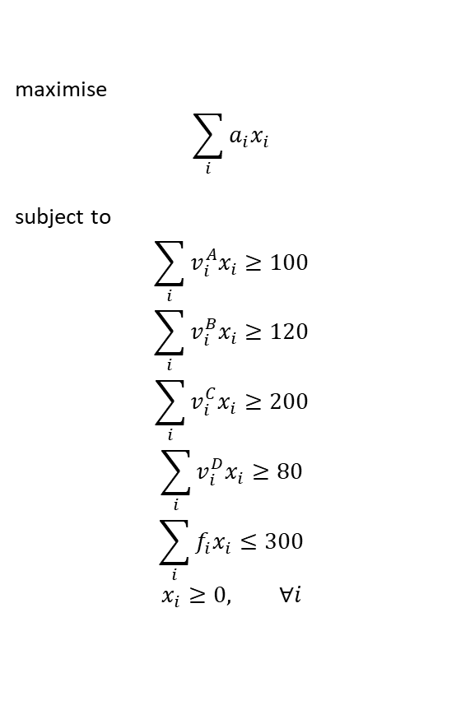
Diet Problem (Tutorial Question 5)
Food | Vitamin A | Vitamin B | Vitamin C | Vitamin D | Fat | Cost | Attractiveness
1 | 18 | 4 | - | 6 | - | 10 | 6
2 | 8 | 6 | 22 | 14 | - | 6 | 1
3 | 22 | 10 | - | - | 8 | 8 | 5
4 | 6 | 12 | - | 6 | - | 16 | 5
5 | - | 14 | - | 10 | - | 8 | 6
6 | - | - | 20 | 8 | 6 | 3 | 4
7 | 8 | - | - | 6 | 20 | 6 | 10
8 | 4 | - | 8 | - | 40 | 8 | 10
9 | - | 6 | 10 | 12 | - | 12 | 6
10 | 12 | 20 | - | 4 | - | 12 | 7
 | Minimum | Maximum
Vitamin A | 100 | -
Vitamin B | 120 | -
Vitamin C | 200 | -
Vitamin D | 80 | -
Fat | - | 300
maximise
$$\sum_{i}{a_{i}x_{i}}$$
subject to
$$\sum_{i}{v_{i}^{A}x_{i}}≥100$$
$$\sum_{i}{v_{i}^{B}x_{i}}≥120$$
$$\sum_{i}{v_{i}^{C}x_{i}}≥200$$
$$\sum_{i}{v_{i}^{D}x_{i}}≥80$$
$$\sum_{i}{f_{i}x_{i}}≤300$$
$$x_{i}≥0, ∀i$$
What is the issue here?
UNBOUNDED!!
The program is free to pick foods with no fat. As long as the vitamin constraints are satisfied, we are in the feasible region and the objective is unbounded.

Slide 15
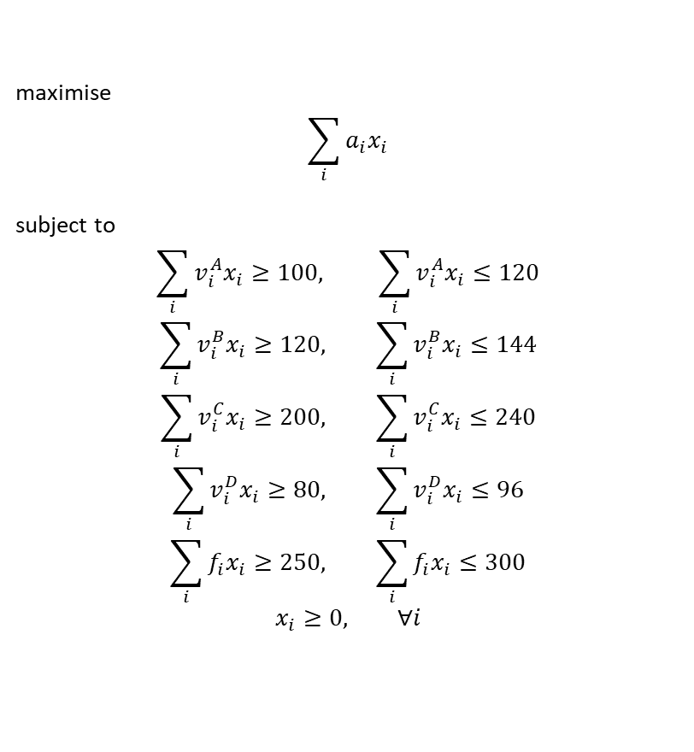
Fix
Maximum and minimum restrictions on both fat and vitamin content, e.g. maximum content = minimum content + 20%.
 | Minimum | Maximum
Vitamin A | 100 | 120
Vitamin B | 120 | 144
Vitamin C | 200 | 240
Vitamin D | 80 | 96
Fat | 250 | 300
maximise
$$\sum_{i}{a_{i}x_{i}}$$
subject to
$$\sum_{i}{v_{i}^{A}x_{i}}≥100, \sum_{i}{v_{i}^{A}x_{i}}≤120$$
$$\sum_{i}{v_{i}^{B}x_{i}}≥120, \sum_{i}{v_{i}^{B}x_{i}}≤144$$
$$\sum_{i}{v_{i}^{C}x_{i}}≥200, \sum_{i}{v_{i}^{C}x_{i}}≤240$$
$$\sum_{i}{v_{i}^{D}x_{i}}≥80, \sum_{i}{v_{i}^{D}x_{i}}≤96$$
$$\sum_{i}{f_{i}x_{i}}≥250, \sum_{i}{f_{i}x_{i}}≤300$$
$$x_{i}≥0, ∀i$$

Slide 16
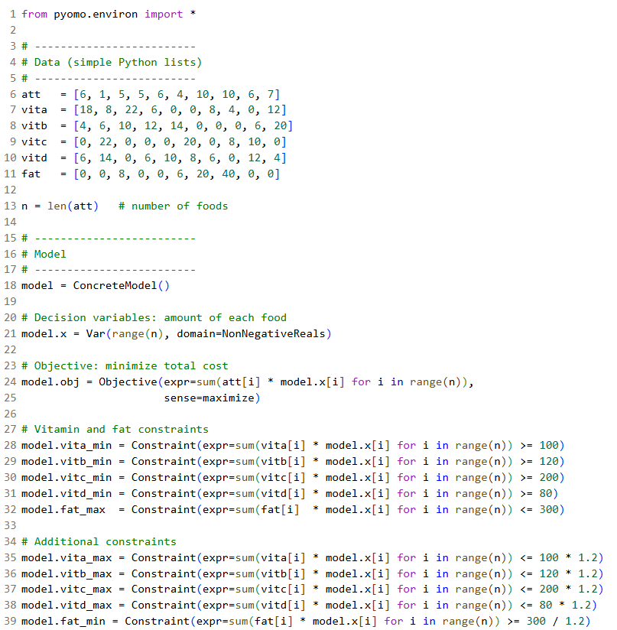
5c Solution via Pyomo (Problem Based)
maximise
$$\sum_{i}{a_{i}x_{i}}$$
subject to
$$\sum_{i}{v_{i}^{A}x_{i}}≥100, \sum_{i}{v_{i}^{A}x_{i}}≤120$$
$$\sum_{i}{v_{i}^{B}x_{i}}≥120, \sum_{i}{v_{i}^{B}x_{i}}≤144$$
$$\sum_{i}{v_{i}^{C}x_{i}}≥200, \sum_{i}{v_{i}^{C}x_{i}}≤240$$
$$\sum_{i}{v_{i}^{D}x_{i}}≥80, \sum_{i}{v_{i}^{D}x_{i}}≤96$$
$$\sum_{i}{f_{i}x_{i}}≥250, \sum_{i}{f_{i}x_{i}}≤300$$
$$x_{i}≥0, ∀i$$

Slide 17
Brief Introduction to Mixed-Integer Linear Programming (MILP)

Slide 18
Manufacturing Problem (Tutorial Q4 Adapted)
A firm manufactures 3 products, X, Y and Z.
Each one is processed by a single machine, machine A, which has a capacity of 100 hours per week.
It takes 4.5 hours to make product X, 2 hours to make product Y and 3 hours to make product Z.
The profit made (per unit) for X, Y and Z is £11.5, £5 and £8 respectively.
The firm only has enough material a week to make 20 of product Z
How many X’s, Y’s and Z’s should be made per week so that the largest profit is made?

Slide 19
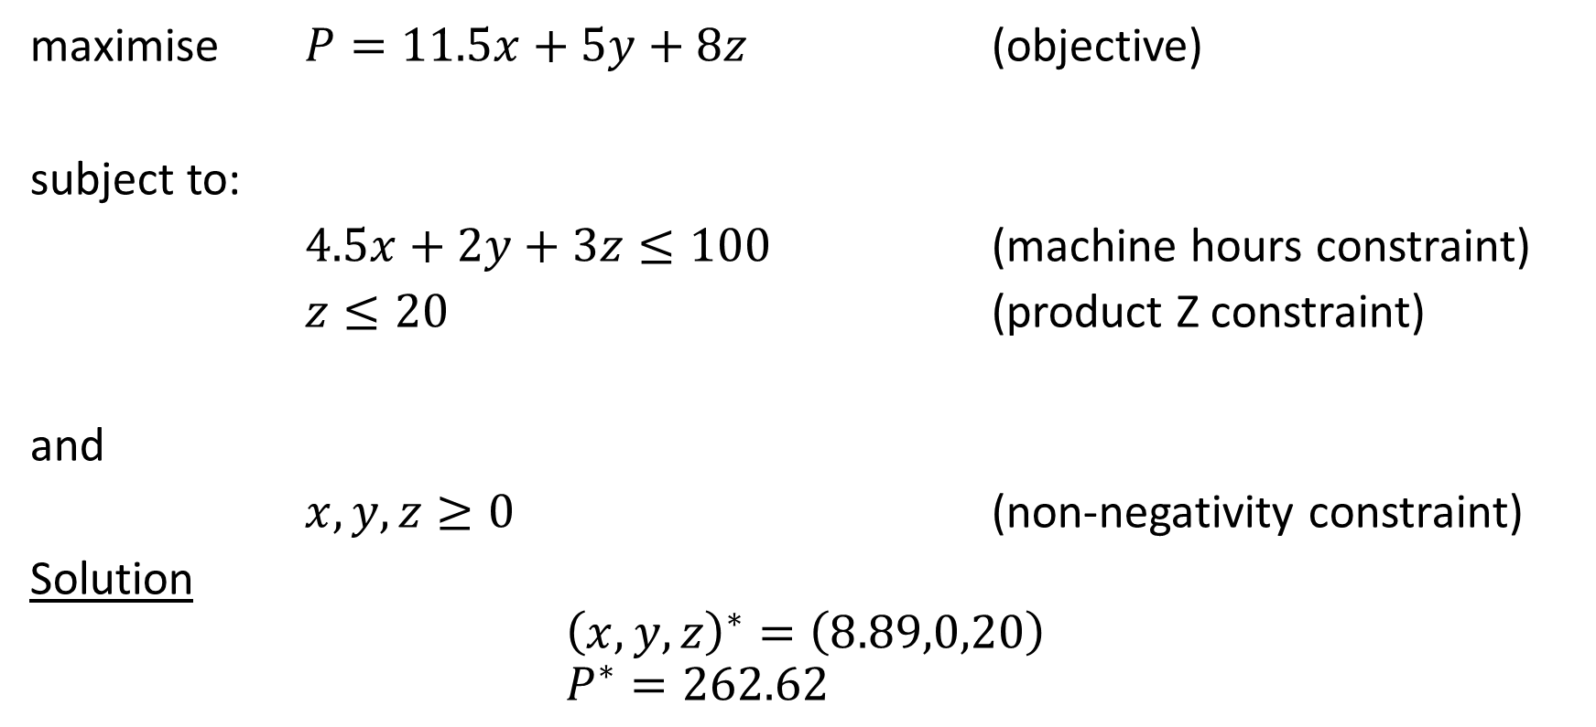
Manufacturing Problem (Tutorial Q4 Adapted)
maximise $P=11.5x+5y+8z$ (objective)
subject to:
$4.5x+2y+3z≤100$ (machine hours constraint)
$z≤20$ (product Z constraint)
and
$x,y,z≥0$ (non-negativity constraint)
Solution
$${\left(x,y,z\right)}^{∗}=\left(8.89,0,20\right) \\ P^{∗}=262.62$$

Slide 20
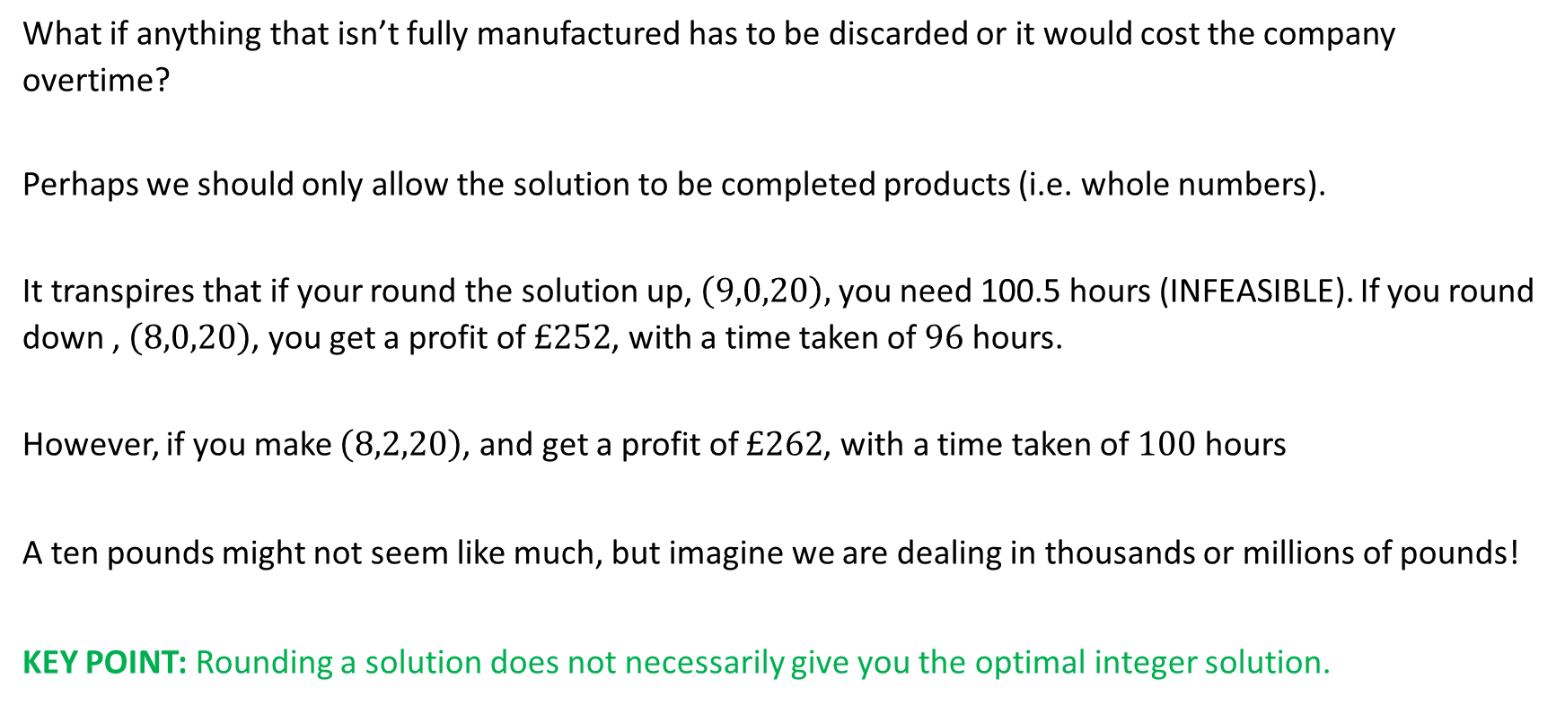
Manufacturing Problem (Tutorial Q4 Adapted)
What if anything that isn’t fully manufactured has to be discarded or it would cost the company overtime?
Perhaps we should only allow the solution to be completed products (i.e. whole numbers).
It transpires that if your round the solution up, $\left(9,0,20\right),$ you need 100.5 hours (INFEASIBLE). If you round down , $\left(8,0,20\right)$, you get a profit of $£252$, with a time taken of $96$ hours.
However, if you make $\left(8,2,20\right)$, and get a profit of $£262$, with a time taken of $100$ hours
A ten pounds might not seem like much, but imagine we are dealing in thousands or millions of pounds!
KEY POINT: Rounding a solution does not necessarily give you the optimal integer solution.

Slide 21
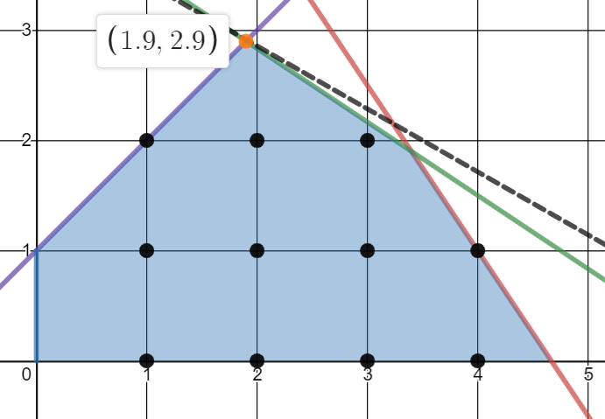
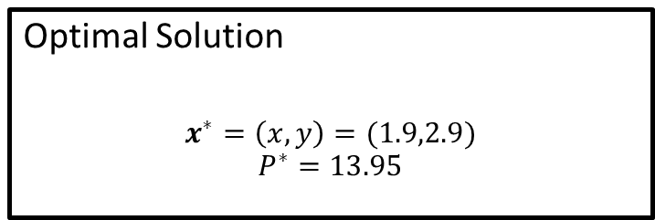


Desmos Demonstration
maximise $P=2x+3.5y$
subject to:
$$3x+2y≤14 \\ 2x+3y≤12.5 \\ −x+y≤1$$
and
$x,y≥0$
$$P=2x+3.5y$$
Optimal Solution
$$x^{∗}=\left(x,y\right)=(1.9,2.9)$$
$$P^{∗}=13.95$$

Slide 22

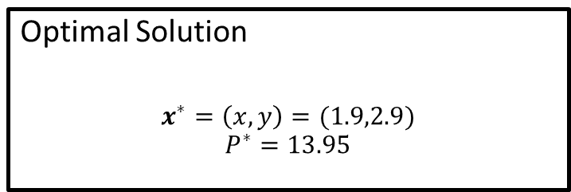
Rounded Solutions
Optimal Solution
$$x^{∗}=\left(x,y\right)=(1.9,2.9)$$
$$P^{∗}=13.95$$
$$P=2x+3.5y$$
$$x=\left(x,y\right)=(1,2)$$
$$P^{∗}=9$$
$$x=\left(x,y\right)=(1,3)$$
Infeasible!
$$x=\left(x,y\right)=(2,2)$$
$$P^{∗}=11$$
$$x=\left(x,y\right)=(2,3)$$
Infeasible!

Slide 23
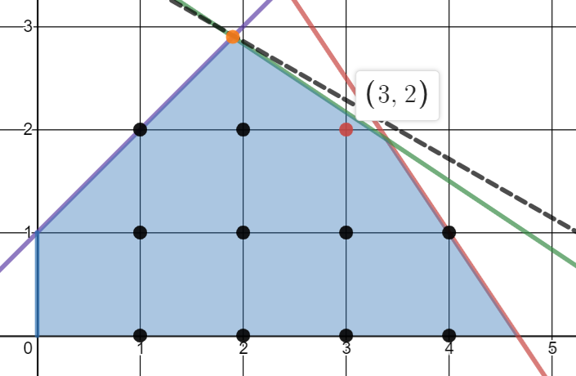


Rounded Solutions
$$x=\left(x,y\right)=(1,2)$$
$$P=9$$
$$x=\left(x,y\right)=(2,2)$$
$$P=11$$
However!
$$x^{∗}=\left(x,y\right)=(3,2)$$
$$P^{∗}=13$$
$$P=2x+3.5y$$

Slide 24
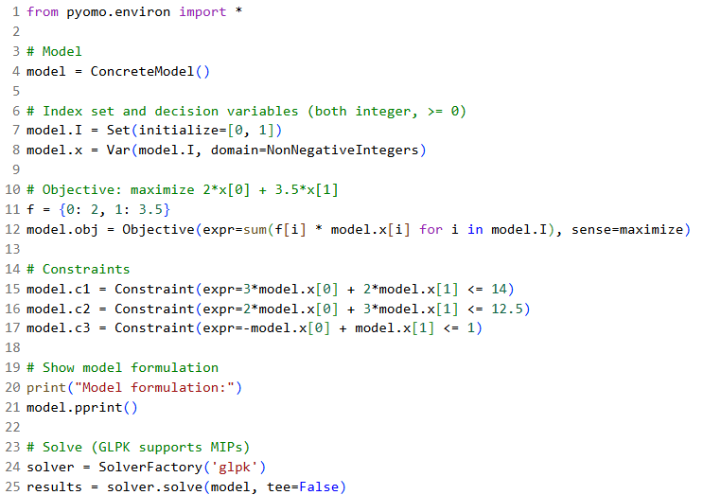
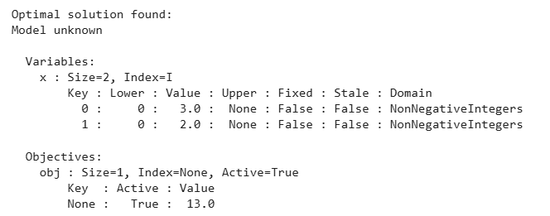
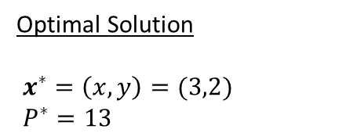
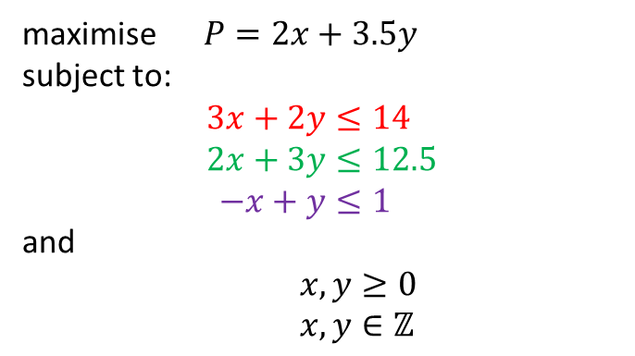
Integer Solution via Pyomo (problem based)
maximise $P=2x+3.5y$
subject to:
$$3x+2y≤14 \\ 2x+3y≤12.5 \\ −x+y≤1$$
and
$x,y≥0$
$x,y∈ℤ$
Optimal Solution
$x^{∗}=\left(x,y\right)=(3,2)$
$P^{∗}=13$

Slide 25
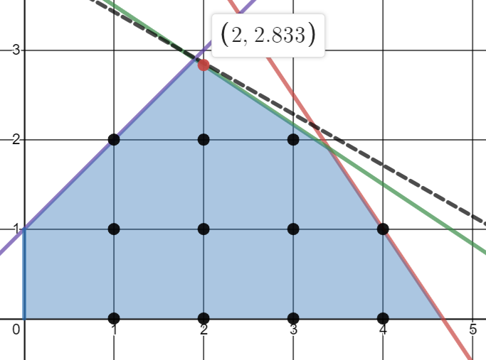

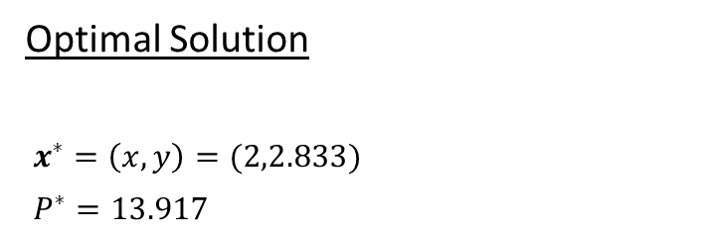
Mixed-Integer Program
maximise $P=2x+3.5y$
subject to:
$$3x+2y≤14 \\ 2x+3y≤12.5 \\ −x+y≤1$$
and
$x,y≥0$
$x∈ℤ$
$$P=2x+3.5y$$
Optimal Solution
$x^{∗}=\left(x,y\right)=(2,2.833)$
$P^{∗}=13.917$

Slide 26
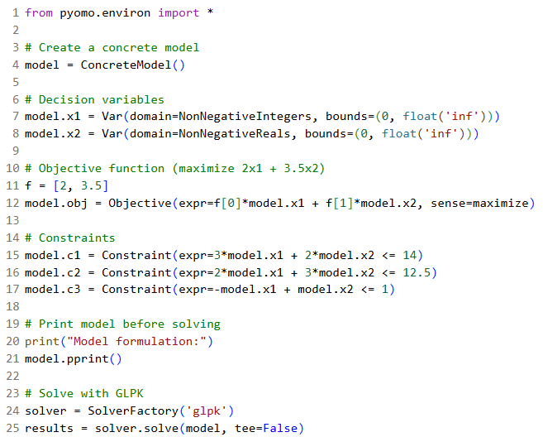
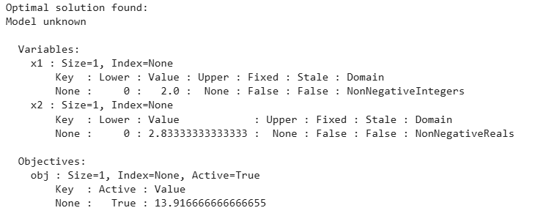
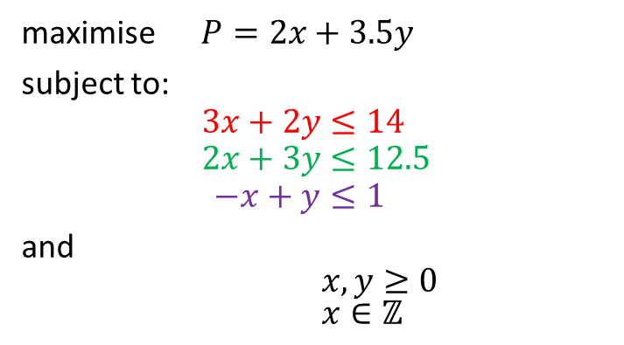
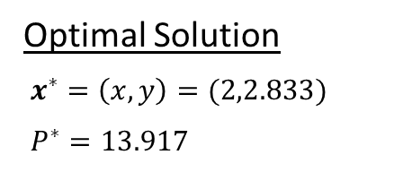
Mixed-Integer Solution (problem based)
maximise $P=2x+3.5y$
subject to:
$$3x+2y≤14 \\ 2x+3y≤12.5 \\ −x+y≤1$$
and
$x,y≥0$
$x∈ℤ$
Optimal Solution
$x^{∗}=\left(x,y\right)=(2,2.833)$
$P^{∗}=13.917$

Slide 27
Demos
https://colab.research.google.com/drive/1y20IlA3po-hK4UWxqkc-Hxk0h6babXlT?usp=sharing

